Slide 2
Accelerator Initiative
Kari Jones
Health Equity Director

Slide 3
About Accelerator
Created by Division of Mental Health and Addiction (DMHA) using American Rescue Plan Act (ARPA) funds designated through HEA1001
Working to co-create change in social conditions for
healthy, just, and equitable communities.
Notes:
About Accelerator
The Accelerator Initiative was created by the Division of Mental Health and Addiction (DMHA) using American Rescue Plan Act (ARPA) funds designated through HEA1001.
DMHA contracted the management of Accelerator to Community Solutions, an Indianapolis-based community development consulting company that works with organizations and other types of groups that are working to improve health, well-being, and quality of life in their community.

Slide 4
Purpose
Strengthen the network of grassroots organizations.
Build resources, connection, engagement, and trust among grassroots organizations and institutional leaders.
Support small grassroots organizations who are responding to the behavioral health needs historically underserved and marginalized communities in Indiana.
Black, Indigenous, People of Color
LGBTQIA+
Criminal Justice System Impacted
Rural Areas
Accelerator Values
Connection
Cultural Sustainability
Equity & Justice
Continuous Learning
Person-Centered Care
Pushing Practice
Reciprocity
Notes:
Purpose
Strengthen and support grassroots organizations.
Grassroots organizations serve historically underserved and marginalized communities.
If we want to dismantle long-standing persistent inequities, grassroots organizations play a major role in improving access to services.
Grassroots organizations and those with lived experience are the best equipped to make decisions around where and how to direct resources.
BIPOC Initiative & Outreach – We invited BIPOC community partners to meet with DMHA staff to provide input on our planning processes and not after we have already created a plan and then ask for a stamp of approval.
Increase BIPOC Workforce, Grant funding to BIPOC orgs, & increase treatment in BIPOC communities.
Feedback on barriers and solutions.
Need for state and government agencies to build relationships in efforts to create trust in BIPOC communities. – foundational and is important in working together effectively
Do not have funds to pay for grantwriters and limited time to write proposals.
Lack of connections in their network with people who are in positions of power.
No contact within DMHA to put a face with/DMHA seemed overwhelming.
Stigma on mental health and addiction in the community.
Lack of funding opportunities. – sustainability
Accelerator Initiative was shaped to address some of the barriers BIPOC orgs (which are usually grassroots organizations) experienced.
It is the vision of the Accelerator Initiative that grassroots leaders have resources and are supported in their efforts to imagine beyond what-has-been-done-before to create programs that are responsive in their communities.
The initiative is guided by the following values:
Connection: We recognize that our strength is in numbers and that change happens through relationship.
Cultural Sustainability: We respect the beliefs, values, and traditions of people and communities.
Equity & Justice: We strive to advance equity for all; specifically, for those who have been historically marginalized and impacted by persistent systemic oppression.
Continuous Learning: We use data to reflect and learn from our efforts and recognize that there are multiple forms of knowledge generation.
Person-Centered Care: We desire to increase the availability, awareness and access to culturally responsive wellness supports.
Pushing Practice: We encourage institutions and systems to think beyond “best practice” to foster curiosity for new ways of being and doing.
Reciprocity: We acknowledge that we each have knowledge and wisdom to offer and share, and opportunities to be humbled as we work toward positive change in our communities.

Slide 5
More than a Funding Opportunity
In addition to providing up to $150,000 in funding to support organizational operations, participating organizations have access to:
Coaching
Content Area Experts
Training
Peer Learning
Grantwriting Support
Sounding board; confidant; inquirer
Regular check-ins
Pointing to resources
Helping to record & share grantees’ journey
Targeted help from people with special expertise
Based on priorities and plans
Funding available through Accelerator
12 monthly sessions
Timing, format, topics based on Grantee interests/ priorities
Some training will be open to the public
Learning exchange activities and tools
Based on Grantee interests/ priorities shared in plans and with Coaches
Support in writing 4 grant applications
Help developing “boilerplate” grant language, if desired
Notes:
More Than Funding Opportunity
Accelerator Grantees will receive up to $150,000 is more than grant funding to support operations for a year and a half.
Received $10,000 for upfront planning.
Presented plan to DMHA in April how they will implement their program – will receive funding to implement.
Coaching
Each grantee was partnered with a coach throughout the duration of the grant period end of 2024.
Planning Phase - Coaches supported grantees as they completed an organizational self-assessment, a strategic growth plan and a technical assistance plan.
Implementation Phase - Coaches will continue to serve as a sounding board and advisor, depending on the interests of the grantee.
Coaches are key partners to ensure the values, approach and learnings of the Accelerator are incorporated consistently and with integrity.
Content Area Expertise
Grantees will receive coaching and customized technical assistance from content area experts, based on the priorities they identified in their Technical Assistance Plan.
Training
A monthly training series will be starting this year that focuses on specific topics of interests and priorities that have been identified by Grantees and coaches.
All sessions will be done as webinars and recorded for additional viewing.
Grantees receive a stipend for their time participating in the series.
Peer Learning
Grantees will have the opportunity organize and form peer learning groups to share knowledge, feedback and experiences to help each other problem solve and share successes. The Accelerator team will support peer learning in ways identified and guided by grantees’ needs. Developing relationships among grantees is an important way to expand networks, collaboration and mutual learning. These activities will be developed based on the interests of grantees, expressed formally through Technical Assistance Plans and informally in many ways (including input and recommendations of coaches).
Grantwriting Support
Grantees will have access to professional grantwriting services at no cost to them.
These services can support the development of boilerplate language (organizational mission/vision/values, history, statement of need, etc.) and the completion and submission of four (4) applications by December 2024.

Slide 6
Accelerator Initiative Timeline:
August 2022 – December 2024
Notes:
Timeline and Phases
The Accelerator was designed during the summer of 2022 and the application to the program was intentionally built in two phases.
The Planning Grant Applications were designed to identify organizations that fit the aims of the initiative (community-rooted, small organizations that are reaching priority populations with resources, supports, and services that bolster mental health and wellbeing) and those that were selected for Planning grants were supported in activities to vision, dream, prioritize, and plan, which then set organizations up for a strong Implementation Grant application and about 18 months of resources and support to implement strategies to build for the future.
In April, grantees presented to DMHA on their implementation proposals and, as of May 1, have officially moved into the grant implementation phase.
While we would have loved to invite some grantees here to speak about their experiences with the initiative, we wanted to honor their process and allow them to focus their time, energy and effort on closing out their planning efforts and developing their implementation proposals.
We encourage you all to follow their progress through the accelerator website.

Slide 7
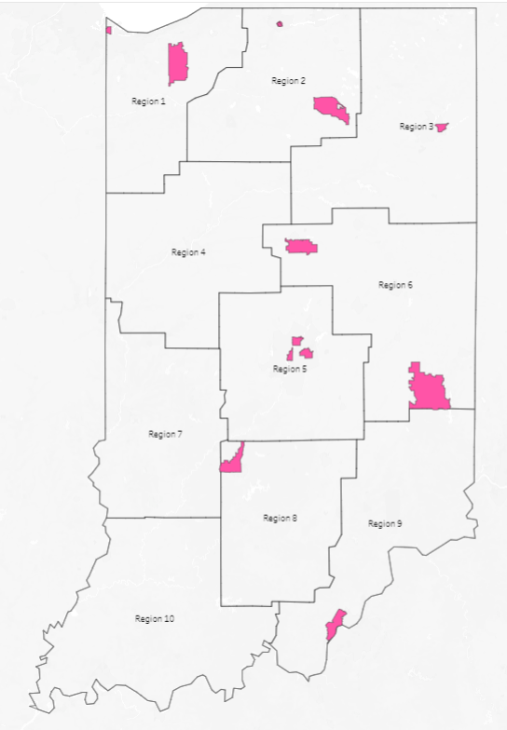
Accelerator Grantees
Centers of Wellness for Urban Women
Clark & Floyd County System of Care
Connection Cafe
Hammond Hispanic Community Committee
Holistic Evolution
Imani and Unidad, Inc.
Indiana Recovery Alliance
Latino/a Youth Collective of Indiana Inc.
The LGBTQ Center
Live Well Kosciusko
Mental Health Awareness Of Michiana, Inc.
Perseverance Partners, LLP
ProjectME-FW
ShipHappens, Inc.
The Ross Foundation
The Shelter, Inc.
Notes:
Accelerator Grantees
This map is divided up by DMHA regions - we have grantees in most regions of the state
Centers of Wellness for Urban Women
Clark & Floyd County System of Care
Connection Cafe
Hammond Hispanic Community Committee
Holistic Evolution
Imani and Unidad, Inc
Indiana Recovery Alliance
Latino/a Youth Collective of Indiana Inc.
The LGBTQ Center
Live Well Kosciusko
Mental Health Awareness of Michiana, Inc.
Perseverance Partners, LLP
ProjectME-FW
ShipHappens, Inc.
The Ross Foundation
The Shelter, Inc.

Slide 8
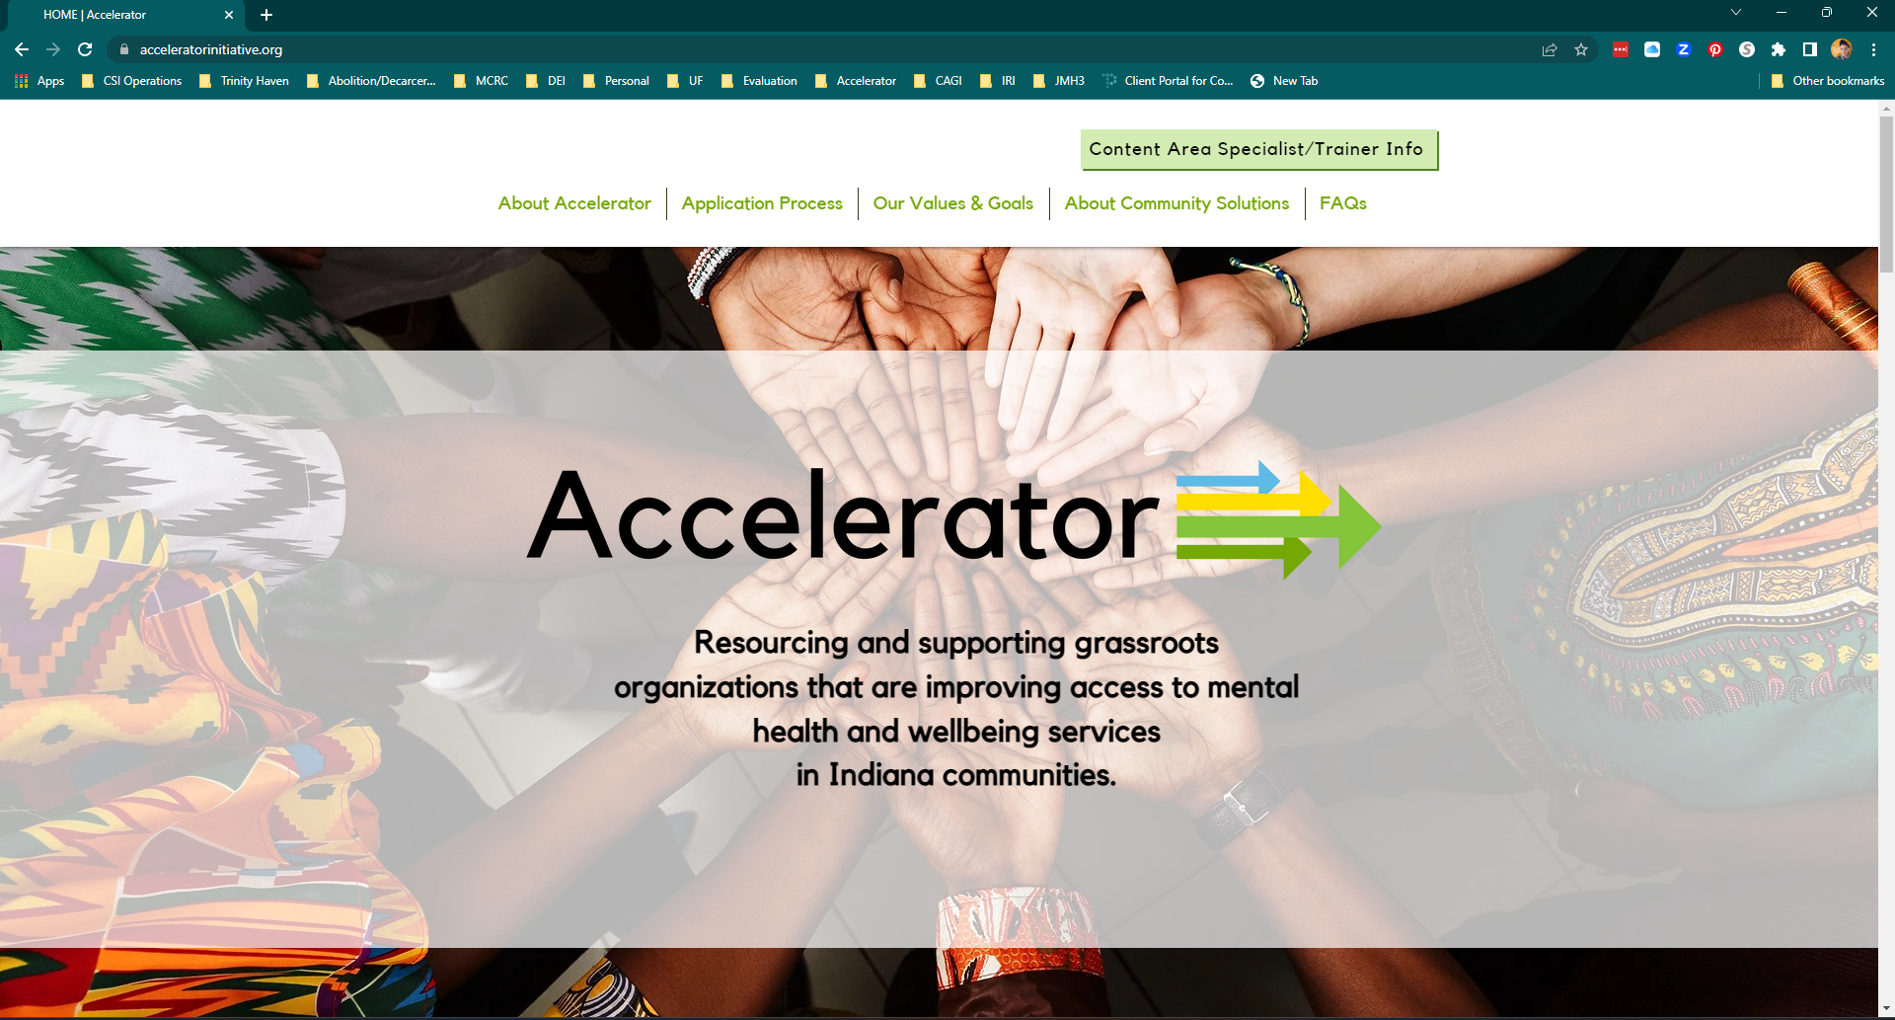
Accelerator Website
https://www.acceleratorinitiative.org
accelerator@communitysolutionsinc.net
Notes:
Accelerator Website (acceleratorinitiative.org)
Includes a wealth of information about the initiative.
I encourage everyone to visit the website to learn more about the initiative.
The website will also house resources that could be useful to grassroots organizations, so please spread the word to organizations you know that could use the resources.

