Slide 1
Strategies in Capacity Building for Innovative and Equitable Mental Health Workforce
Gina Woodward
Director, Behavioral Health Workforce Development
Gina.Woodward@fssa.in.gov
Notes:
Indiana Family and Social Services Administration

Slide 2
Initiate a culture of support and collaboration Introduce a broader context for discussion of workforce strategy and solutions Review common themes in contemporary workforce development and how they may relate to Indiana’s behavioral health workforce needs Provide an update regarding DMHA workforce effort and initiatives
Objectives

Slide 3
Creating a Vision for Workforce Development
Opportunity
Talent
Skill

Slide 4
Indiana Behavioral Health Commission Report
“Access to quality behavioral health care is ultimately dependent upon having enough well-trained individuals to deliver that care.”
GOAL:
To improve the recruitment, retention, and quality
of the behavioral health workforce in Indiana

Slide 5
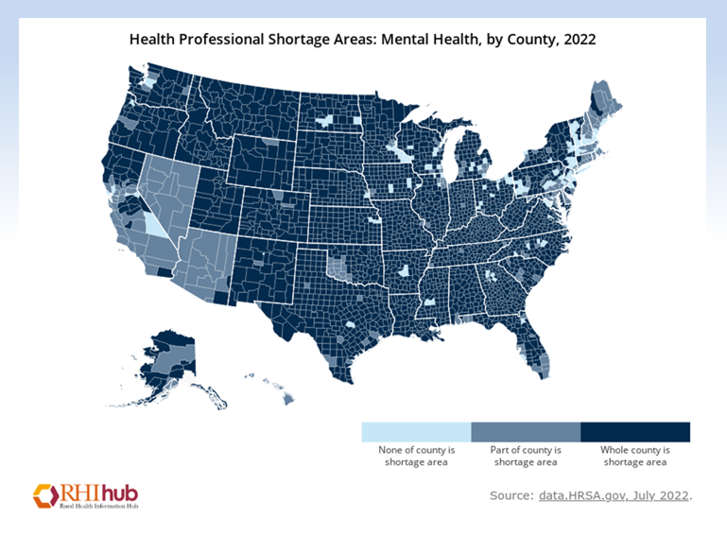
Barriers & WF impact
Over 1000 US counties have no MH or SUD professional
By the year 2028, the majority of HPSA scores are predicted to reflect a critical shortage - level of need is skyrocketing across the country
Need to respond to immediate needs AND predict / plan for future needs…
CRISIS RESPONSE & INNOVATION
are imperative in strategic development related to BH workforce development
Health Resources and Services Administration | HRSA

Slide 6
Barriers & WF impact
Workforce trends impacting WF crisis
Turnover
Where services are delivered
How services are delivered
Increased demand for services

Slide 7
“Burnout”
Capacity
Nearly 2 in 3 behavioral health workers (65%) reported increasing client caseloads
More than 7 in 10 (72%) reported increased client severity since the COVID-19
More than 9 in 10 behavioral health workers (93%) said they are experiencing burnout (majority reporting severe burnout (62%)
Nearly half (48%) of behavioral health workers say the impacts of workforce shortages have caused them to consider other employment options
90% of behavioral health workers are concerned about care access
87% are concerned about the ability to provide care in the event of a future health care crisis
New Study: Behavioral Health Workforce Shortage Will Negatively Impact Society - National Council for Mental Wellbeing (thenationalcouncil.org)

Slide 8
Barriers & WF Impact
Existing BH WF is not reflective of populations being served
AVG AGE
51.5
46.5
45
49
54
Clinical Mental Health Provider Type | # of Indiana Counties lacking FTE Provider Type | % representing a demographic population other than white
Psychologists | 31 | 8.5%
LCSW (social work) | 3 | 10.8%
LMHC (counselor) | 9 | 11%
LMFT (marriage/family counselor) | 27 | 9.7%
LCAC (addictions) | 11 | 9.2%
Bowen Center for Health Workforce Research and Policy | IU School of Medicine

Slide 9
Barriers & WF impact
Who / How / Why’s of Care ACCESS
Access to mental health care is not equal or equitable across all populations
BIPOC
LGBTQ+
Rural
Linguistically diverse
Multiple factors can impact an individuals’ access to mental health care
Stigma
General distrust of the healthcare system
Lack of culturally competent providers, insurance plans, and other resources

Slide 10
Barriers & WF Impact
Access & Identification of Need
Only 26.4% of Black and Hispanic men ages 18 to 44 who experienced daily feelings of anxiety or depression were likely to have used mental health services, compared with 45.4% of non-Hispanic White men with the same feelings.
Historical barriers in education (specifically, higher education) restrict the well-roundedness of our behavioral health workforce
Indiana’s 2021 Youth Risk Behavior Survey (YRBS) results show that students reporting mental health concerns differ across demographic groups (LGBTQ+; Multiracial)

Slide 11
2023 DMHA Workforce Development Priorities
Data
Collect and review data on Indiana’s Behavioral Health Workforce in terms of diversity, gaps, compared to other states, current funding initiatives, and outcomes, etc.
Define
Defining the shortage for Indiana in terms of geography, profession, license type, site, current programs/initiatives
Develop
Strategy for developing workforce in terms of collaborations, partnerships, policy, legislation, funding
Notes:
Data à Define à Develop
Pre-workforce (Building the pipeline into the field from middle school, high school)
Direct Service Workforce (Peers, CHWs, CMs, OBHPs)
Mid-level workforce (LMFT/A, LMHC/A, LSW/LCSW, LCAC/LACs)
Advanced-level workforce (psychologists, psychiatrists, advanced psychiatric nurse practitioners)
Data (Where are we)
Where are we in the State of Indiana with Behavioral Health Workforce?
Types of professionals, Number of professionals by field, Number of practicing licenses, Number serving in our public sector BH workforce, CMHC workforce picture,
How diverse is our BH Workforce?
Where do we compare to other states? National average?
What projects, funding, initiatives do we already have in place?
What partnerships are there, etc.?
Where are we with initiatives targeting pre-workforce?
Define (What do we need)
Define the “shortage” for our state
Where is the shortage? What are the...regional? statewide trends?
Is the shortage specific to a certain skillset?
What gaps exist?
What professional types/licenses are underrepresented?
What programs/collaborations are needed to build the pipeline?
Develop (Where are we going)
Strategy for developing workforce in terms of collaborations, partnerships, policy, legislation, funding

Slide 12
Promote
Recruit
Train
Retain

Slide 13
Focus Across All Levels
Preparation – Skill - Service
Early Workforce
Develop behavioral health careers as a potential field with middle school, high school
Entry Level Workforce
Peers, CHWs, CMs, OBHPs, Assoc / Bachelors-level
Mid-level Workforce
LMFT/A, LMHC/A, LSW/LCSW, LCAC/LACs, Peers, Nurses (RN); QBHP
Advanced-level Workforce
Psychologists, Psychiatrists, Adv. Psych NPs

Slide 14
Strategies & Recommendations
Increasing diversity in the mental health and substance use services field
can lead to greater cultural competency
and increase the ability of health care providers
to offer services that meet the
unique social, cultural and linguistic needs of their clients

Slide 15
Workforce Development =
Talent
Skill
Opportunity

Slide 16
Strategies & Recommendations
Morehouse School of Medicine - African American Behavioral Health Center of Excellence
(AABH-COE) - National Council on Mental Wellbeing : BH Workforce Equity Focus Groups
Diversify Executive Ranks
Increase community education / stigma reduction programs
Community-partnered engagement strategy
Faith-based orgs
Increase the use of trusted community partners

Slide 17
Strategies & Recommendations
Focus on improving the treatment experience
Create mentorship and peer-to-peer support programs
Affinity groups
Increase salaries and wages
Flexible supports (modified educational requirements; loan reimbursement; housing stipends; retirement savings plans)
Additional TA / resources are needed for effective recruitment and retention for culturally reflective workforce
Organizations may lack knowledge or understanding of the specific needs of BIPOC professionals

Slide 18
Strategies & Recommendations
Create a culture of learning
Professional learning collaboratives / mentorship programs
Organizations must plan for supports to be integrated through the work life cycle, from recruiting to retirement, including all stages of retention
PARTNERSHIP
Educational learning collaboratives / mentorship programs
For long term impact, similar barriers that exist in education / higher education must be managed using similar strategies
Prioritize Safety and Belonging
Integrate DEI
Acknowledge differences in needs and lived experiences

Slide 19
Workforce Development and the CCBHC Model
Strengthen the whole ecosystem by linking behavioral health care with other community pillars such as education, justice, and housing systems
Build tailored treatment pathways for individuals, rather than fit complex individuals into a one-size fits all approach

Slide 20
Development and the 988 Crisis Response System
“A comprehensive and integrated crisis network is the first line of defense in preventing tragedies of public and patient safety, civil rights, extraordinary and unacceptable loss of lives, and the waste of resources.” - SAMHSA’s National Guidelines for Behavioral Health Crisis Care
Indiana DMHA understands that one vital element of an effective no-wrong-door approach to crisis care is available providers to do the work that are consistent, competent, confident and caring

Slide 21
DMHA Work in Progress
Workforce Recruitment and Retention Innovation Initiative
Locally- identified priorities and solutions
Emphasis on collaborative efforts
Planning for sustainability
Highlighting the importance of culturally reflective WF through evaluation
Data informed through lived experience
Statewide Early Workforce Development Focus
Human and Social Services graduation pathway review
North – Central – Southern approach based on prevention areas
ASPIN – SW Intern Program
Community Health Workers (CHW) – expanded scope and application

Slide 22
For additional information:
Homepage - National Council for Mental Wellbeing (thenationalcouncil.org)
Indiana Behavioral Health Commission Report
Health Resources and Services Administration | HRSA
Bowen Center for Health Workforce Research and Policy | IU School of Medicine
Health: MCH: Youth Risk Behavior Survey (in.gov)

