Slide 1
Cultural Competency and Mental Health
Immigrant and Refugee Population

Slide 2
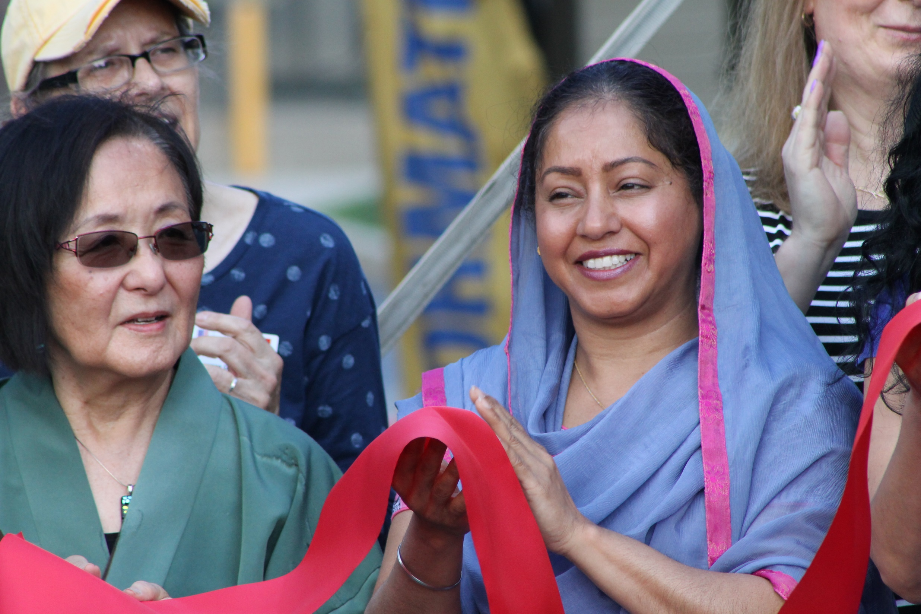
Blank Title and Content
About Us
Amani Family Services is a private nonprofit organization serving more than 2,000 families and individuals from around the world who have made Allen County their home.
Formerly Crime Victim Care of Allen County, an organization founded in 2006, Amani is the only local nonprofit agency entirely devoted to serving refugee and immigrant families and individuals.
Amani
Peace (Kiswahili), aspirations or wishes (Arabic)

Slide 3
A Culturally Competent Employee
Actively identifying cultural bias and assumptions
Actively working to understand other worldviews
Actively working on skill development for persons of different cultural background
5104 N Clinton St, Fort Wayne, IN 46825 | amanifamilyservices.org

Slide 4
Dimensions of Cultural Competence

Slide 5
Awareness
Move from unaware to aware
Aware of biases and how it affects services for minority clients
Challenges assumptions
Comfortable with differences between themselves and clients
Aware of limitations professionally and ethically
Aware of detrimental beliefs and attitudes
5104 N Clinton St, Fort Wayne, IN 46825 | amanifamilyservices.org

Slide 6
Application
Self-reflection and individual supervision to as to not impose
Disengage from cultural oppression
5104 N Clinton St, Fort Wayne, IN 46825 | amanifamilyservices.org

Slide 7
Understanding Worldview
Seek knowledge and information
Explore relevant issues to the people group that is being served
5104 N Clinton St, Fort Wayne, IN 46825 | amanifamilyservices.org

Slide 8
Application
Aware of sociopolitical systems and effects on marginalized people groups
Identify institutional barriers that inhibit access to mental health and community services
5104 N Clinton St, Fort Wayne, IN 46825 | amanifamilyservices.org

Slide 9
Skills
Awareness of helping style
Recognize limitations
Anticipate impact
5104 N Clinton St, Fort Wayne, IN 46825 | amanifamilyservices.org

Slide 10
Application
Clinical intervention methods with focus on indigenous healing
Send clear verbal and non-verbal message appropriately
Institutional intervention methods as needed
Active systemic focus; helping roles
5104 N Clinton St, Fort Wayne, IN 46825 | amanifamilyservices.org

Slide 11
Systemic Intervention

Slide 12
Application
Active helping style
Community based or in-home services
Change environmental conditions not client
Clients encountering problems; they are not problems
Prevention over remediation
More responsibility over course and outcome
Unshared assumptions leading to barriers
5104 N Clinton St, Fort Wayne, IN 46825 | amanifamilyservices.org

Slide 13
What do we mean by Mental Health?

Slide 14
As Defined by the CDC...
Emotional, psychological and social well-being
Thinking plus feeling plus acting and how everything works together
How one handles stress, relates to others and their ability to make healthy choices
5104 N Clinton St, Fort Wayne, IN 46825 | amanifamilyservices.org

Slide 15
Predisposing Factors
Early adverse life experiences
Trauma
Abuse
Use of alcohol or drugs
Feeling lonely or isolated
5104 N Clinton St, Fort Wayne, IN 46825 | amanifamilyservices.org

Slide 16
Specific Obstacles for Immigrants and Refugees
Language access
Not enough providers available in native languages
Untrained or under-trained interpreters
Access to quality health care
Uninsured or underinsured populations
Mental health often being categorized as a specialty and not primary care
Isolation from their support systems
Immigrants and refugee families are often far away from their families and social circles that could have provided support
Countries in states of emergency
Needing to flee for their life
Immigration obstacles depending on country of origin
Economic state of the countries of origin
Country’s health care systems in shambles because of government unrest
5104 N Clinton St, Fort Wayne, IN 46825 | amanifamilyservices.org

Slide 17
Respect for Mental Health being Health

Slide 18
Culture vs. Medicine
Not all cultures see mental health diagnosis as a verified medical diagnosis
Can be viewed as optional
Can be viewed as a “crazy” diagnosis
Cultures could view religious practices as preferred options for treatment and/or healing
Hesitation to take medications
A person’s available financial resources vs. their mental health need
Uninsured clients fear large medical bills as a result of mental health treatment
Language access fears
Fears of being misunderstood
Fears of being misdiagnosed
Community shared fears as a result of their mental health experiences
5104 N Clinton St, Fort Wayne, IN 46825 | amanifamilyservices.org

Slide 19
Challeges For Providers

Slide 20
Proper interpretation of experiences, treatments and diagnosis
Misdiagnosis due to lack of understanding of symptoms as described
May not have the proper term in their native language
Religious belief differences
Inconsistency in attending services due to before mentioned fears
Improperly trained interpreters that do not interpret all things stated in the session or introducing their own thoughts
5104 N Clinton St, Fort Wayne, IN 46825 | amanifamilyservices.org

Slide 21
How to Promote Mental Health Respectfully

Slide 22
Increasing language access/financial options for the uninsured/underinsured
Proper interpretation training
Cultural and religious training
Community support
Promoting options for the community to become properly trained and provide interpretation services
Encouraging clients to follow medication regimens as direction and communicating regularly with the prescribing doctor the items that are not working
Risks of stopping medications without doctor approval
Dangers of sharing medication
Off market medications and dangers of taking medications not prescribed
Assuring that clients understand the dosage instructions
Encouraging therapy alongside the taking of prescribed medication
Normalizing therapy
Not just for extreme mental illness
Eliminating community myths of therapy
5104 N Clinton St, Fort Wayne, IN 46825 | amanifamilyservices.org

Slide 23
References
https://www.nami.org/Blogs/NAMI-Blog/July-2019/Mental-Health-Challenges-in-Immigrant-Communities
https://www.cdc.gov/mentalhealth/learn/index.htm#:~:text=What%20is%20mental%20health%3F,others%2C%20and%20make%20healthy%20choices.
5104 N Clinton St, Fort Wayne, IN 46825 | amanifamilyservices.org

Slide 24
Connect with us
5104 N Clinton St
Fort Wayne, IN 46825
260-484-1414
amanifamilyservices.org

