Slide 1
From Cultural Linguistic Competency to Equitable Integrated Systems: FSSA
2023 DMHA CLC Conference
Notes:
Indiana Family and Social Services Administration

Slide 3
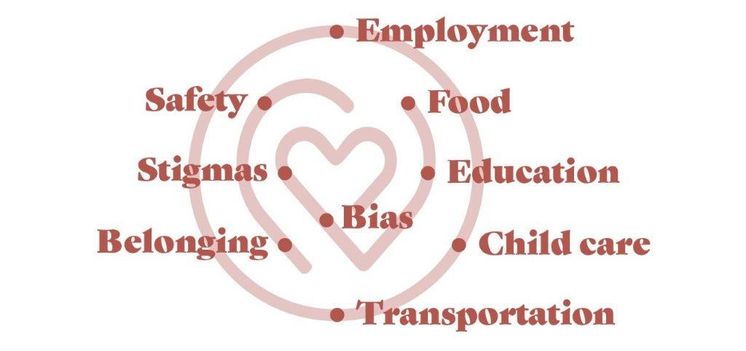
Office of Healthy Opportunities
OHO was established to work with communities served by FSSA to:
identify individuals’ social risk factors for their wellbeing and
address those risk factors through programs, services, and policy design.
Social equity occurs when all individuals and communities experience optimal well-being and quality of life…Social equity cannot be achieved solely by allocating resources in “equal parts”, but by recognizing some groups and individuals need additional resources to achieve the same outcomes.
We identify risk factors and address them.

Slide 4
Agency Efforts
Workforce support and rate methodology
Pathways to Aging: Caregivers and equitable managed care
Process improvement: Director of Barrier Reduction
Broader support for CCBHC model

Slide 5
OHO Goals

Slide 6
Area 1: Community Engagement
User Testing Group
Community Outreach Toolkit
Barrier Reduction Partnerships
Community Event Planning

Slide 7
Area 2: Policy and Program Design
Accommodations Toolkit
Language Access Planning
MCE Roundtables
Policy Recommendations

Slide 8
Area 3: Workforce Development
Adverse Complaints and Incident Reporting System (ACIRS)
Employee Resource Groups (ERGs)
Life Experience Project Q&A
Resource Repository

Slide 9
Area 4: Accountability and Evidence
FSSA Staff Climate Dashboard
FSSA SDOH Data Validation Initiative
Pathways to Aging SDOH Assessment

Slide 10
Community Approaches
What can you do to support or advance your own goals?
Be vocal: FSSA won’t know if you don’t share
Especially gaps in services, client experiences
Let us know how we can support your events, initiatives
Data sharing and trend reporting

Slide 11
Thank You! healthyopportunities@fssa.in.gov

